Slide 1
EExxpplloorriinngg UUIIPPaatthh SSttuuddiioo:: PPrroojjeeccttss
aanndd UUsseerr IInntteerrffaaccee

Slide 2
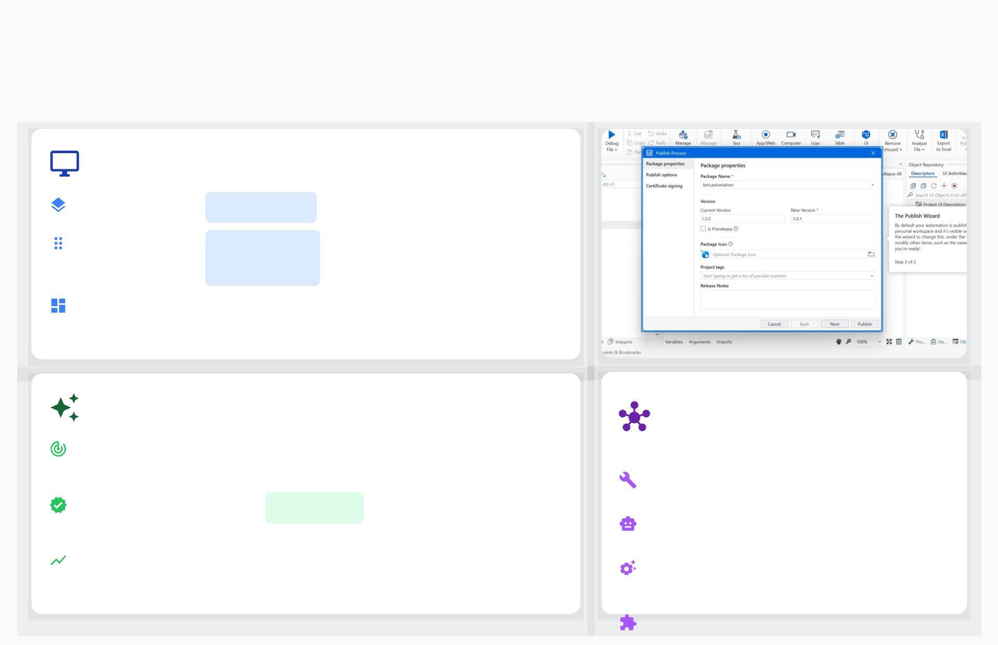
Introduction to UIPath Studio
Understanding the Core of RPA Automation
What is UIPath Studio?
A robust tool for
large-scale
, end-to-end automation.
Features an
intuitive
drag-and-
drop
visual interface for building
workﬂows.
The Designer panel is the central hub for project
modiﬁcations and access to variables and arguments.
Purpose and Beneﬁts of RPA
Key Platform
Components
Purpose:Automate repetitive, rule-based digital tasks using
software bots.
Studio:
The development environment
.
Beneﬁts:Reduces
errors, boosts
eﬃciency
, and frees employees
for strategic work.
Robot:Executes the automations.
Leads to higher operational excellence and customer
satisfaction.
Orchestrator:
Deploys, manages, and
monitors.
Extensions:
For seamless web

Slide 3
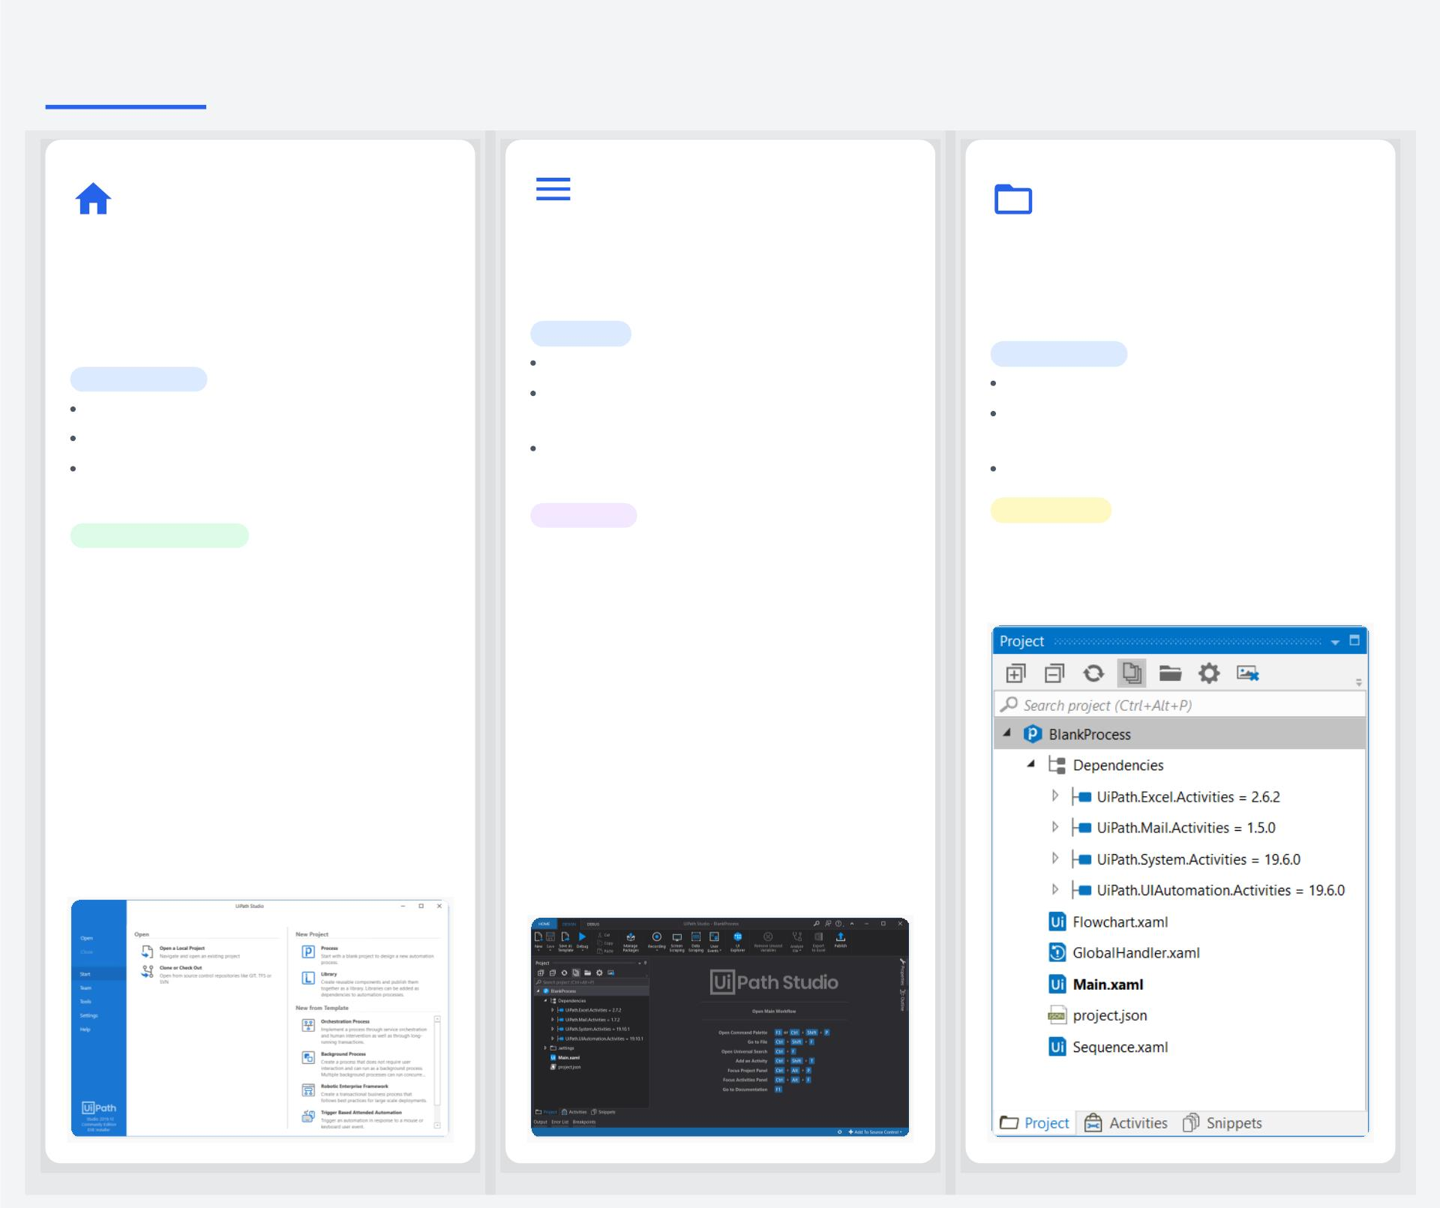
UIPath Studio User Interface: Overview
Home Panel & Project
Menu Bar & Ribbon
Projects Panel & File
Explorer
Templates
A dynamic toolbar at the top of the
window, providing access to all major
design and debugging functionalities.
The initial view when opening Studio. It's
the central hub for starting new projects,
opening existing ones, and conﬁguring the
environment.
Manages all ﬁles, dependencies, and
settings for your current automation
project in a structured, hierarchical view.
Key Tabs
Home: Project creation and settings.
Functionality
Functionality
Design: Build workﬂows, manage
View and ﬁlter project contents.
Create and open automation projects.
Access Studio settings and preferences.
packages, and publish.
Manage external packages and
libraries.
Debug: Test, set breakpoints, and
View documentation and license
details.
monitor execution.
Adjust project-speciﬁc settings.
Feedback
Integration
Project Templates
Allows users to submit ideas or report
bugs directly to the UiPath product team.
Shows ﬁle status icons for projects
connected to GIT, SVN, or TFS source
control.
Start projects from predeﬁned templates
to streamline setup and ensure
consistency.

Slide 4
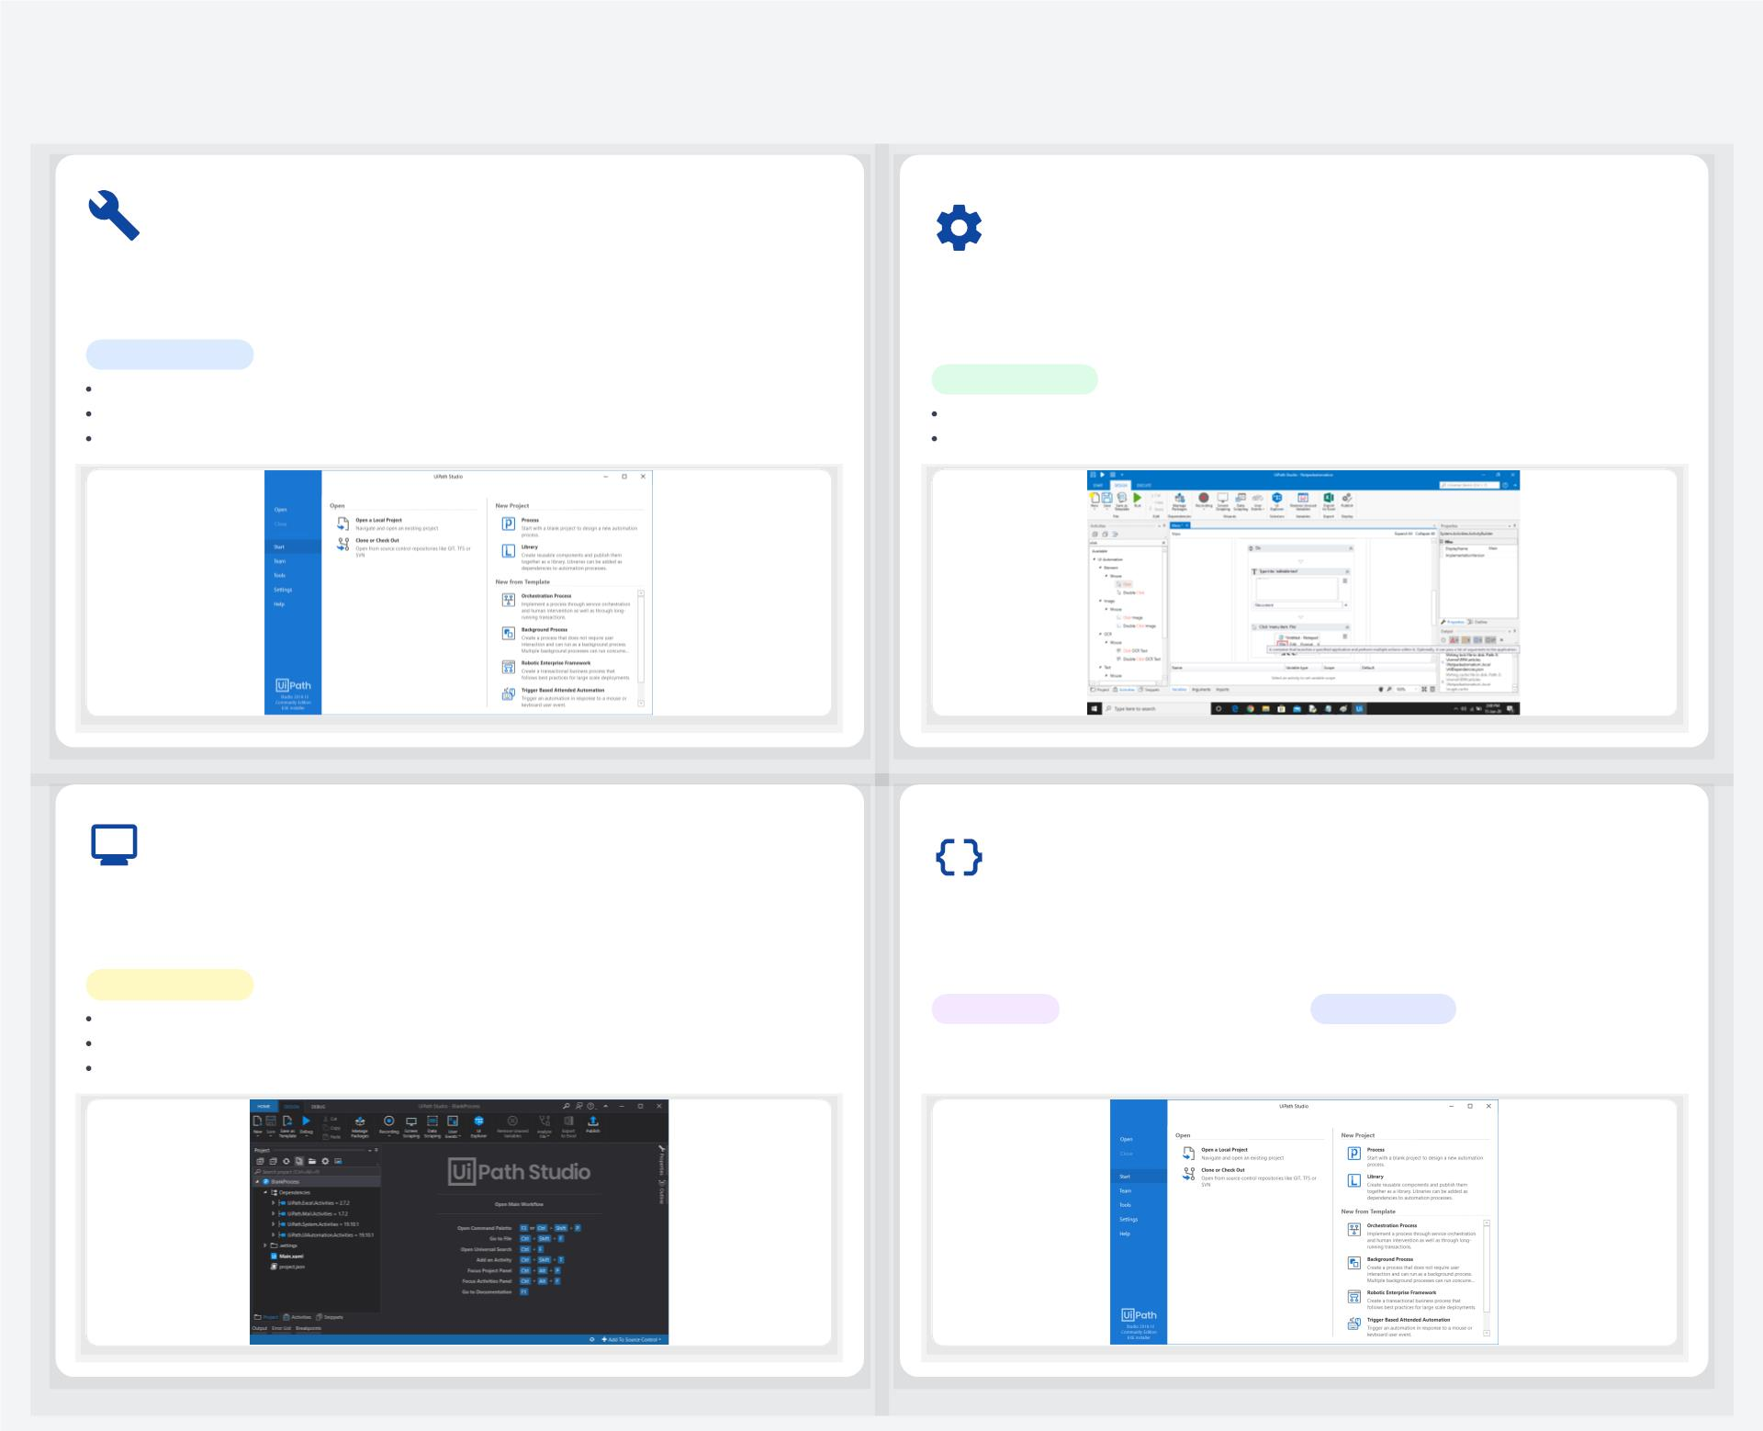
Key Interface Components
Activities Panel: Exploring Actions
Properties Panel: Conﬁguring
Activities
Displays available activities to add to a workﬂow. Drag and drop
activities into the Designer panel to build automations.
A contextual panel to view and modify the properties of a selected
activity, essential for customizing its behavior.
Functionality
Search for activities by name or description.
Add frequently used activities to a favorites list.
Install activities from uninstalled packages.
Functionality
Adjust parameters, inputs, and outputs.
Access the Expression Editor for intelligent code completion.
Output Panel: Monitoring Execution
Variables & Arguments: Data
Management
Displays output from activities like 'Log Message' and shows
exceptions. Used for debugging and monitoring execution.
Manages data ﬂow within and between workﬂows. Provides quick
access to variables, arguments, and imports.
Functionality
Filter messages by log level (e.g., errors, warnings).
View details and copy log messages.
Export logs to a text ﬁle for analysis.
Variables
Arguments
Bound to a container; visible only
within their deﬁned scope.
Used to pass data between workﬂows;
available everywhere in a ﬁle.
- User Interface, Workﬂow Design

Slide 5
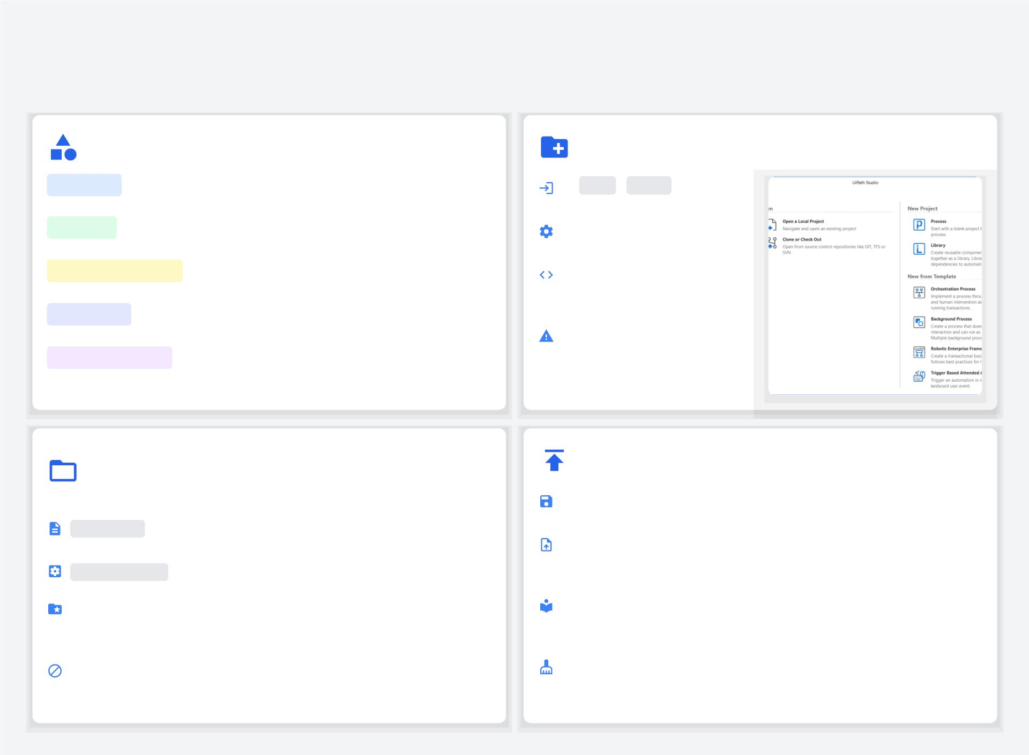
Creating and Managing Projects in UIPath Studio
From Project Types to Publishing Your Automations
UIPath Project Types
Creating a New Project
Process: Automates a speciﬁc business process, published for
Go Home > Start and select a
robot execution.
to
project type.
Library: Creates reusable components (workﬂows) to be used as
dependencies in multiple processes.
Conﬁgure Name, Description,
and Location.
Test Automation: Speciﬁcally for designing and executing test
automation projects.
Choose Compatibility (e.g.,
Windows, Cross-platform) and
Language (VB or C#).
Template: Design a process and publish it as a starting point for
other similar projects.
Note: Compatibility and
language cannot be changed
after creation.
Cross-platform: For unattended automations and web
automations executable on Windows & Unix-like OS.
Project Folder Structure & Key
Files
Saving and Publishing Projects
Saving:Projects are auto-saved, but manual saving ensures your
: The default main workﬂow ﬁle where the automation
starts.
latest changes are committed.
Main.xaml
Publishing:This packages your project into a `.nupkg` ﬁle,
making it available for robots to execute via
Orchestrator or locally.
project.json
: Contains metadata and dependencies for your
automation project.
Subfolders:Projects include dedicated folders for screenshots,
local data, settings, and templates to keep resources
organized.
Reusable
Libraries can be published and used as
Components:dependencies in other projects, promoting code
reuse.
Naming
Restrictions:
Avoid special characters like `\ / : * ? " < > |` in
ﬁle names.
Cleanup:Use the `Remove Unused` feature to remove
unreferenced variables, dependencies, and screenshots
before publishing for a clean, optimized package.
Source: About Automation Projects - UiPath Documentation

Slide 6
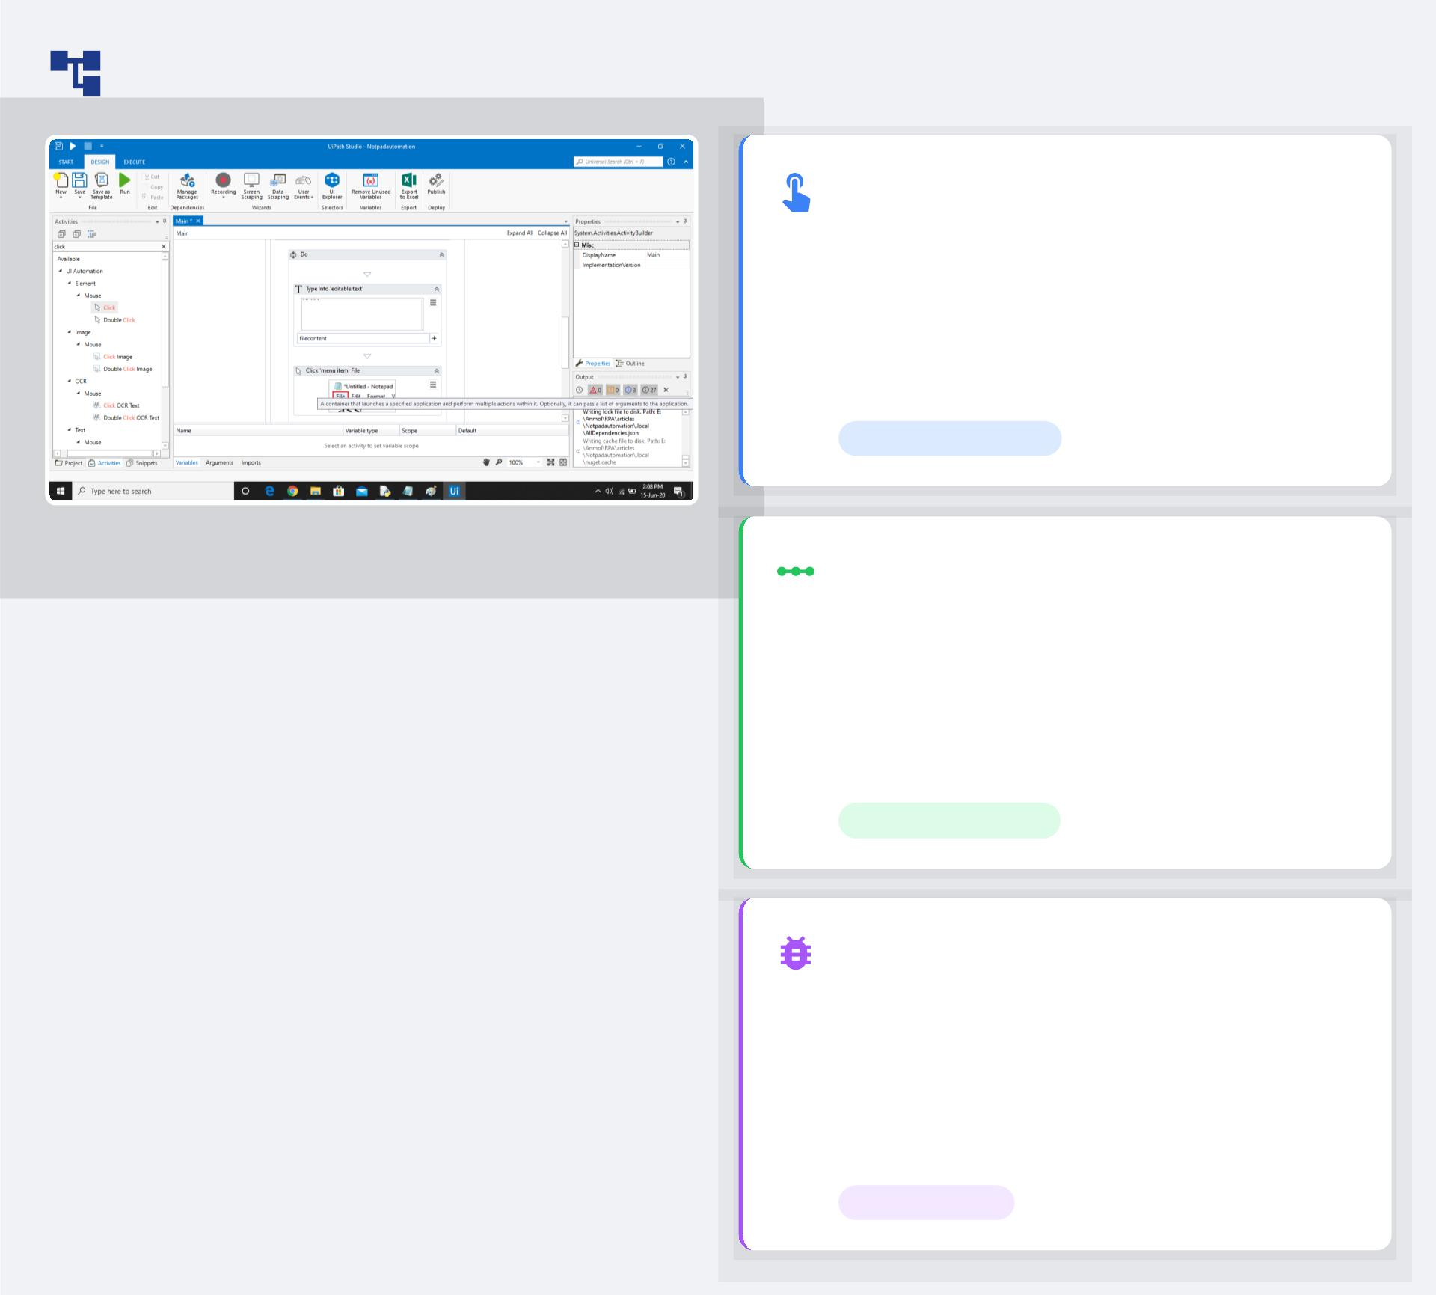
Workﬂow Design: The Main Canvas
Dragging and Dropping
Activities
Intuitively construct your automation by dragging
pre-built activities from the Activities Panel and
dropping them onto the design canvas. This visual
approach accelerates development and simpliﬁes
complex process mapping.
Visual Construction
The Design Area: Build with Sequences,
Flowcharts, and State Machines.
Connecting Activities & Flow
Control
Deﬁne the logic of your automation by connecting
activities. Use control ﬂow elements like loops (For
Each, While) and conditionals (If, Switch) to
manage the sequence of operations and handle
diﬀerent scenarios.
Logical Sequencing
Debugging and Running
Workﬂows
Test and reﬁne your automation with powerful
debugging tools. Set breakpoints, step through
execution, and monitor data in real-time. Once
perfected, run the workﬂow to see your automated
process in action.
Test & Execute

Slide 7
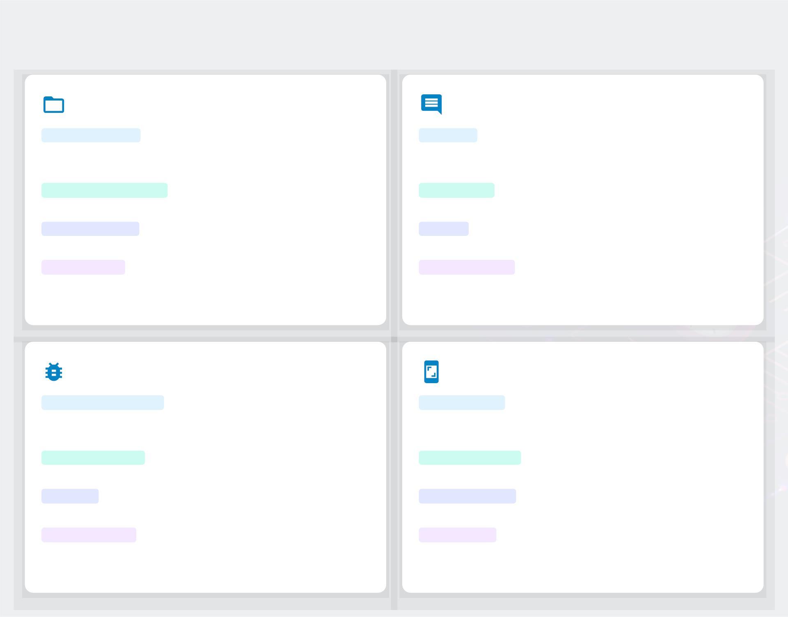
Best Practices and Tips
Organizing Projects for Scalability
Using Comments and Annotations
Modular Design
Break down complex processes into
Purpose
Use comments and annotations to describe
smaller, reusable components for eﬃciency and easier
maintenance.
techniques, application behavior, or complex logic in
detail.
Use clear, consistent names for
ﬁles, activities, and variables to improve readability.
Integrate with systems like Git to track
Improves understanding for other
developers who may work on the project.
Explains complex logic or speciﬁc decisions
Naming Conventions
Readability
Version Control
Clarity
changes and enhance collaboration.
made within the workﬂow, providing essential context.
Orchestrator Utilize Orchestrator for large-scale
Maintainability Aids in future debugging and
modiﬁcations by providing a clear record of the
automation's design.
operations, load balancing, and queue management.
Error and Exception Handling
Importance of Screenshots
Robust Mechanisms
Implement strong error handling to
Visual Clarity
Screenshots provide clear visual context
manage exceptions gracefully and prevent process
crashes.
for UI automation steps, making workﬂows easier to
understand.
Try-Catch Blocks
Use `Try-Catch` blocks to isolate code
Troubleshooting
Help identify issues by showing the
that may fail and deﬁne a recovery sequence.
exact state of an application when an error occurred.
Logging Utilize logging activities to track execution
Documentation Enhance project documentation by
paths, which is invaluable for troubleshooting.
visually illustrating steps, conﬁgurations, or error states.
Conﬁgure a Global Exception Handler to
deﬁne a consistent error response across the project.
UiPath can automatically generate
informative screenshots for UI activities.
Global Handler
Informative
s

Slide 8
Understanding User
Interfaces

Slide 9
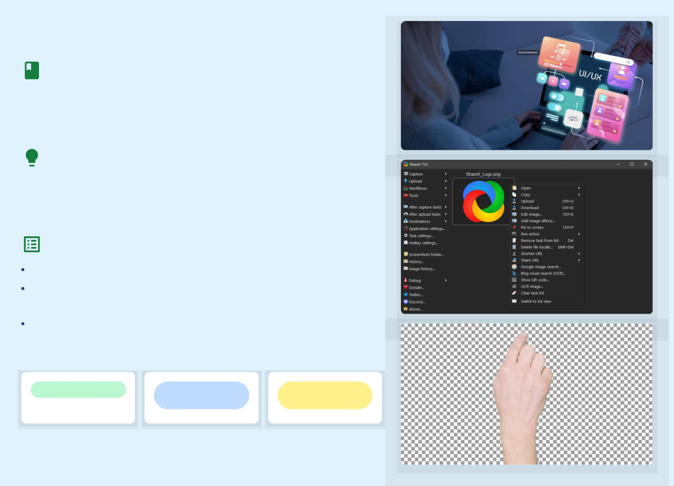
What is a User Interface (UI)?
Deﬁnition
The point of interaction between humans and computers. It's the
space where users and machines meet to exchange information
and commands.
Purpose
Enabling users to control and interact with software/hardware. UIs
are designed to be intuitive and eﬃcient, facilitating seamless
communication.
Examples
Websites: Navigating online content, e-commerce platforms.
Mobile Apps: Interacting with apps on smartphones and
tablets.
Operating Systems: The graphical environment of your
computer.
Interaction Point
Control &
Command
User-Centric
Design
Source: Human-Computer Interaction | EBSCO Research Starters, Input Devices and Interaction Techniques for Advanced Computing

Slide 10
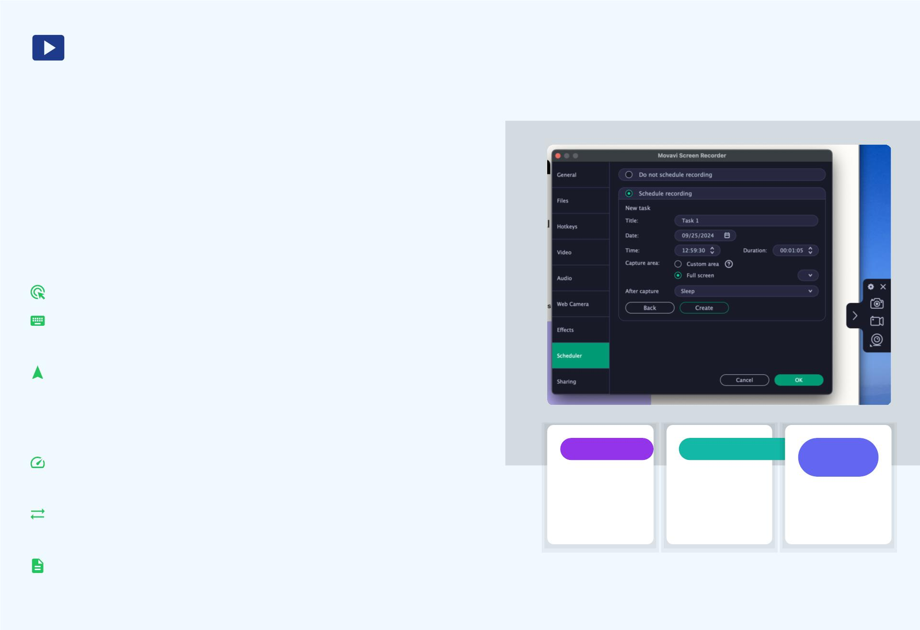
Introducing the Task Recorder
What it is
A Task Recorder is a powerful tool designed to capture and replay
user actions within an application or web page. It automates
repetitive tasks by meticulously logging every interaction.
How it works
The recorder operates by capturing a sequence of user inputs. Th
includes:
Clicks:Registering mouse clicks on speciﬁc UI elements.
Keystrokes:Recording all keyboard inputs, including text entr
and shortcuts.
Navigation:Documenting movements between screens and
pages.
Beneﬁts
Automation
Reproducibility
Process
Capture
Eﬃciency:Automates repetitive tasks, saving time and
Automate
repetitive
digital tasks.
Replay
actions for
testing &
demos.
reducing manual eﬀort.
Document
workﬂows
accurately.
Consistency:Ensures tasks are performed identically every
time, minimizing human error.
Documentation:Creates an accurate record of workﬂows for
training and analysis.
Source: User interface interaction recorder within RPA -research scope; UiPath Studio User Guide

Slide 11
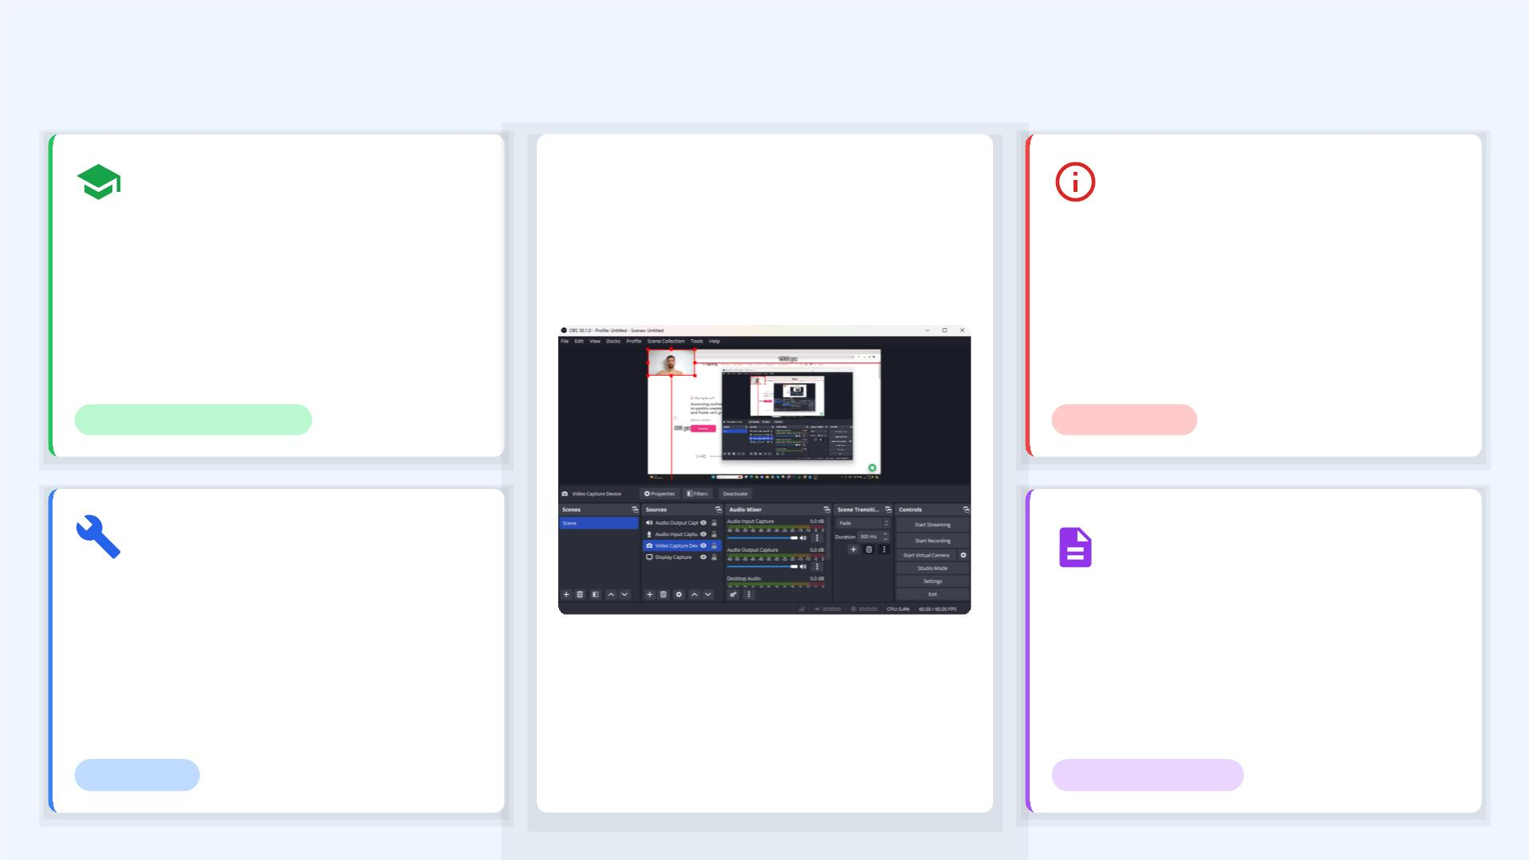
Practical Applications of Task Recorders
Training & Onboarding
Troubleshooting
Create step-by-step guides for new
employees or users. Task recordings
provide visual, interactive tutorials,
reducing training time and ensuring
consistency.
Document issues by recording the exact
steps that lead to an error. This provides
clear, reproducible evidence for support
teams, accelerating problem diagnosis.
Recorded Task Playback
KNOWLEDGE TRANSFER
DIAGNOSTICS
Automated Testing
Process
Documentation
Replicate user scenarios for automated
testing. Recorded tasks can be used to
build test scripts, ensuring software
functionality and identifying regressions.
Standardize workﬂows by capturing and
documenting best practices. This ensures
adherence to established procedures and
facilitates knowledge transfer.
A visual example of a recorded user session, ready
for playback and analysis.
EFFICIENCY
STANDARDIZATION
Source: User interface interaction recorder within RPA -research scope..., UiPath Studio User Guide

Slide 12
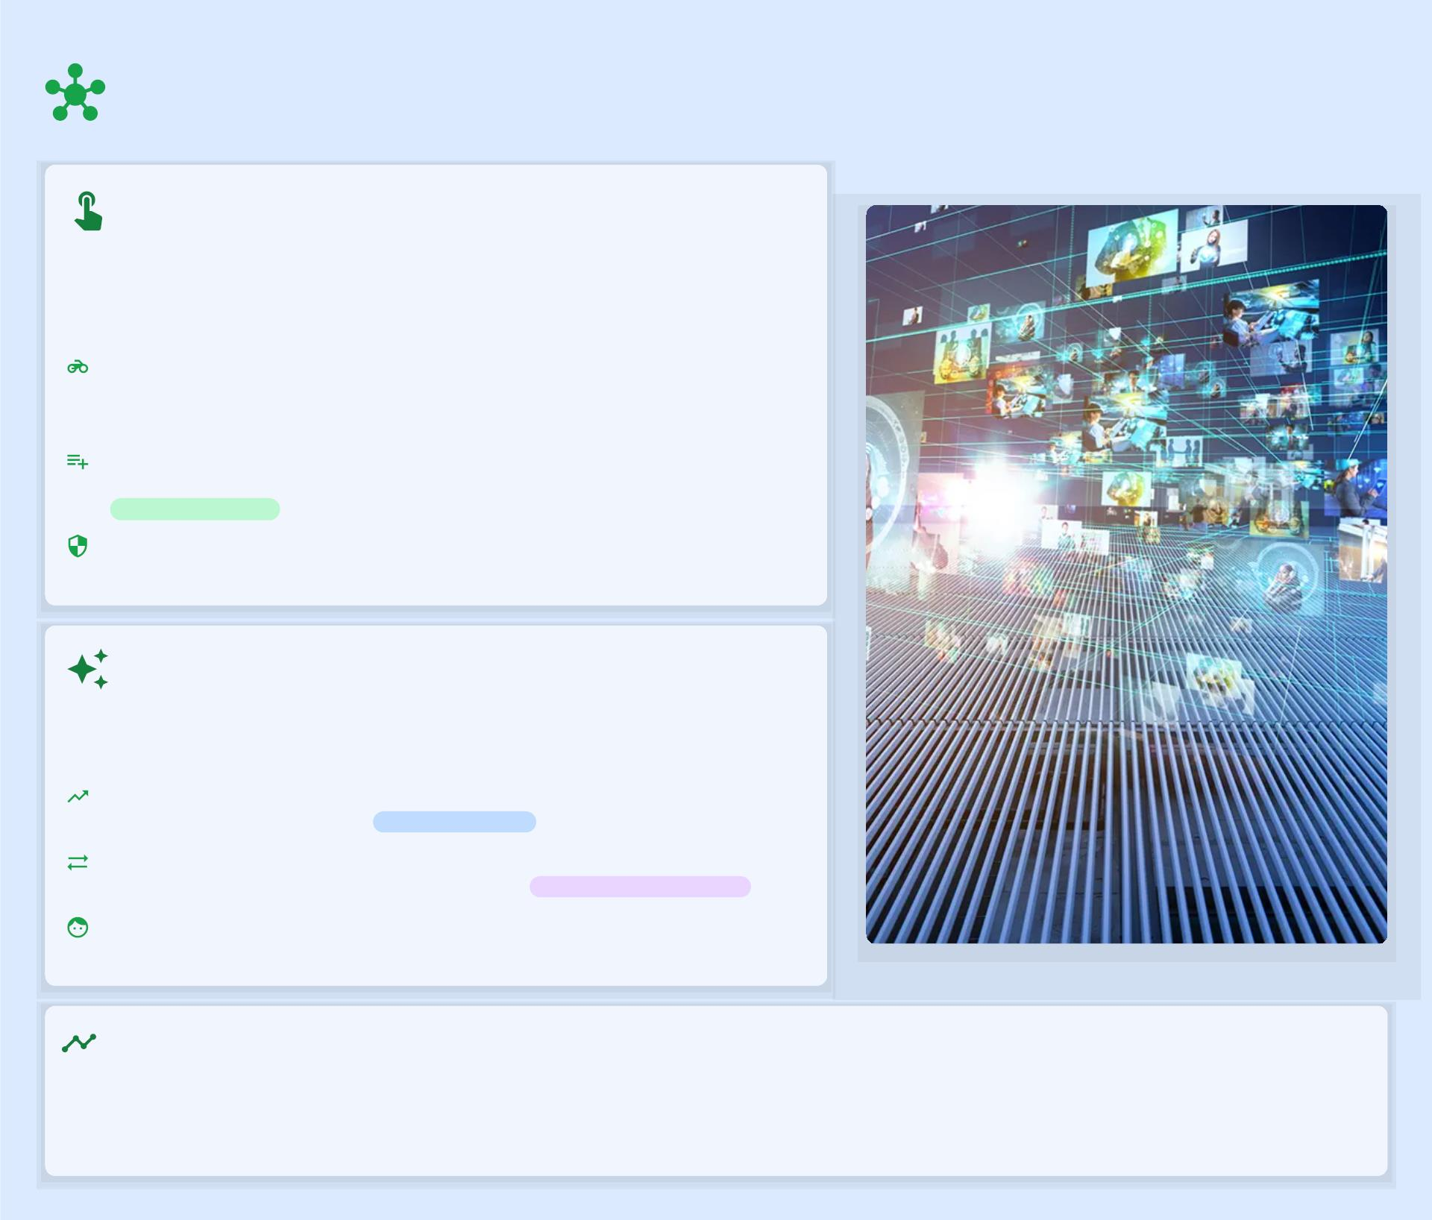
Advanced UI Interactions: Engaging with
Technology
Beyond Traditional Input
Moving beyond the conventional mouse and keyboard, advanced UI
interactions explore new modalities for human-computer dialogue. This
includes:
Touchless Interaction: Utilizing gestures, gaze, and voice
commands for seamless control, especially in sterile or hands-free
environments.
Multimodal Interfaces: Combining various input devices like
cameras and sensors with AI to interpret complex user data.
Multimodal Input
Wearable Devices: Integrating technology directly into accessories
for continuous and intuitive interaction.
Enhancing User Experience
The goal is to create more intuitive, pleasurable, and eﬃcient
interactions. Key aspects include:
Natural Interaction: Mimicking human-to-human communication
for more intuitive control.
Intuitive Control
Perceptual-Motor Interaction: Linking user perceptions with
physical actions for immediate feedback.
Immersive Experiences
User-Centered Design: Tailoring technology to speciﬁc user needs,
ensuring ease of use and satisfaction.
The Evolution of Human-Computer Interaction
HCI has evolved from command-line interfaces to graphical user interfaces, and now towards more sophisticated, natural, and
immersive interactions. The future promises seamless communication between human cognition and technology, making
interaction almost invisible.
Source: Human-Computer Interaction | EBSCO Research Starters, Input Devices and Interaction Techniques for Advanced Computing, Touchless, Direct Input Methods for Human-
Computer Interaction to ...

Slide 13
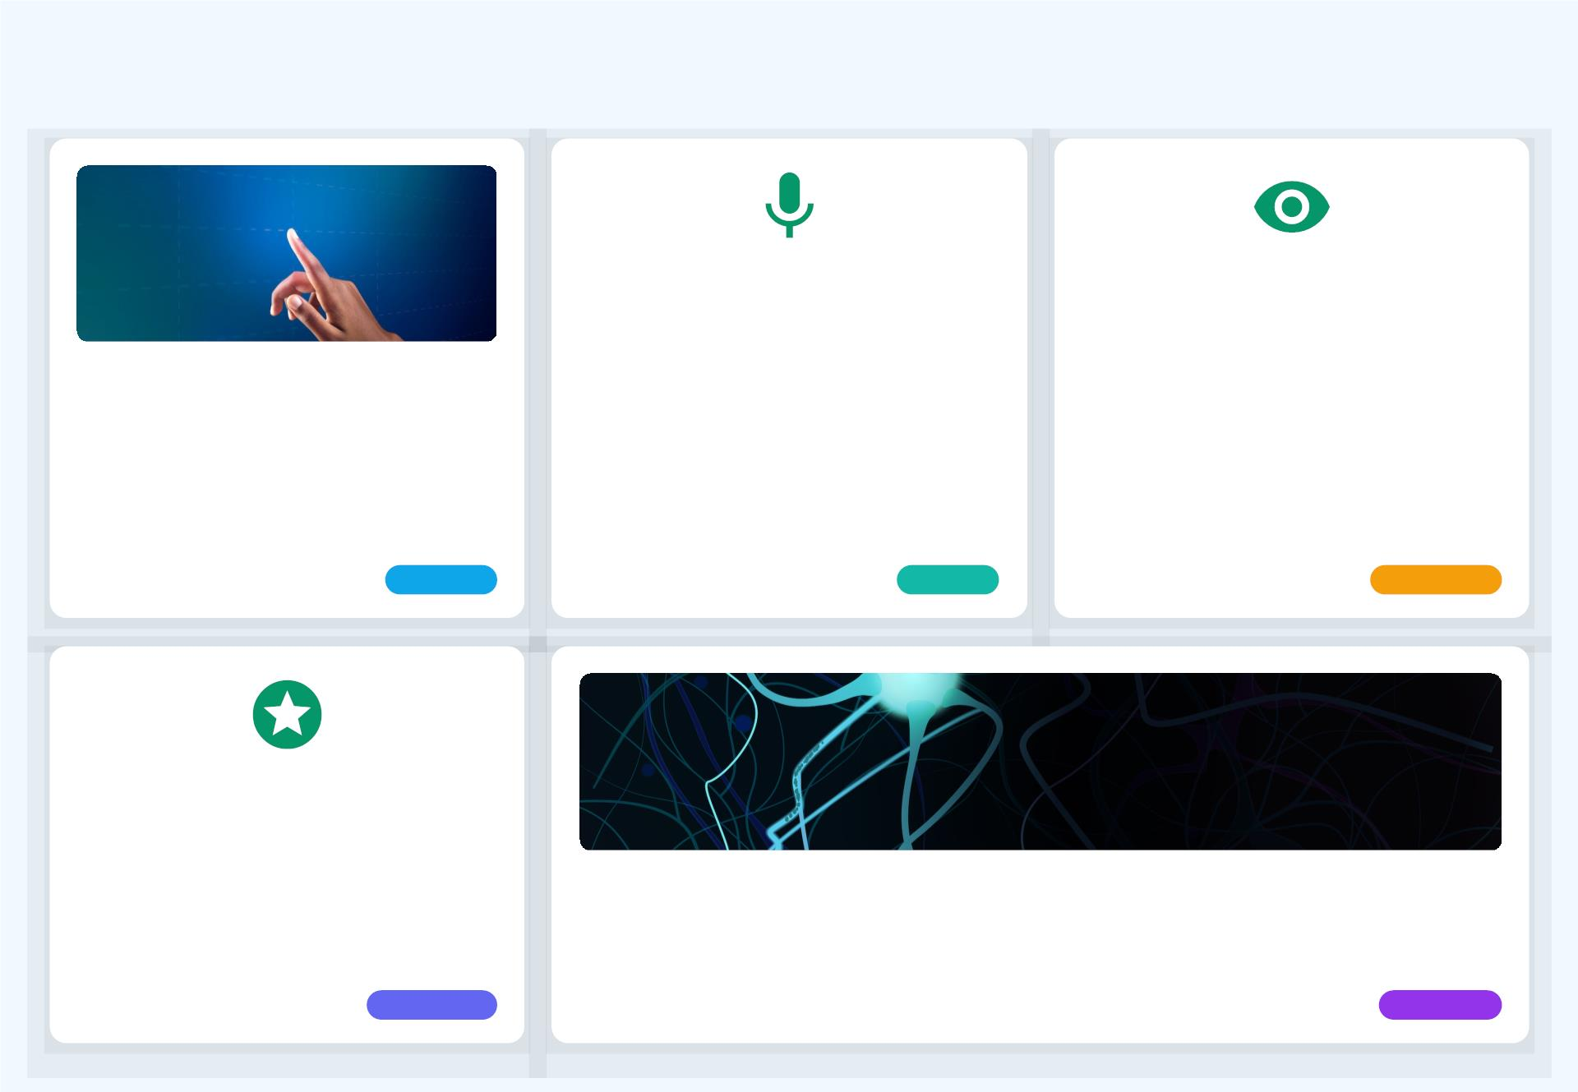
Input Methods: New Ways to Command
Voice Recognition
Eye Tracking
Enables control through spoken
commands. Popular examples include Siri,
Alexa, and Google Assistant, allowing
hands-free interaction with devices and
services.
Allows users to control interfaces and
navigate content simply by moving their
gaze. This method oﬀers precise, low-
eﬀort interaction, particularly useful for
accessibility.
Touch & Gesture
Utilizes multi-touch screens for intuitive
interactions like swiping, pinching, and
tapping. This method mimics natural
human hand movements for direct
manipulation.
Intuitive
Natural
Accessible
Haptic Feedback
Provides tactile sensations to the user,
enhancing interaction by simulating touch,
pressure, or vibration. It adds a physical
dimension to digital experiences.
Brain-Computer Interfaces (BCI)
Directly translates neural activity into commands, oﬀering unprecedented control for
individuals with limited mobility and opening new frontiers in human-computer interaction.
Immersive
Futuristic
Source: Human-Computer Interaction | EBSCO Research Starters, Input Devices and Interaction Techniques for Advanced Computing

Slide 14
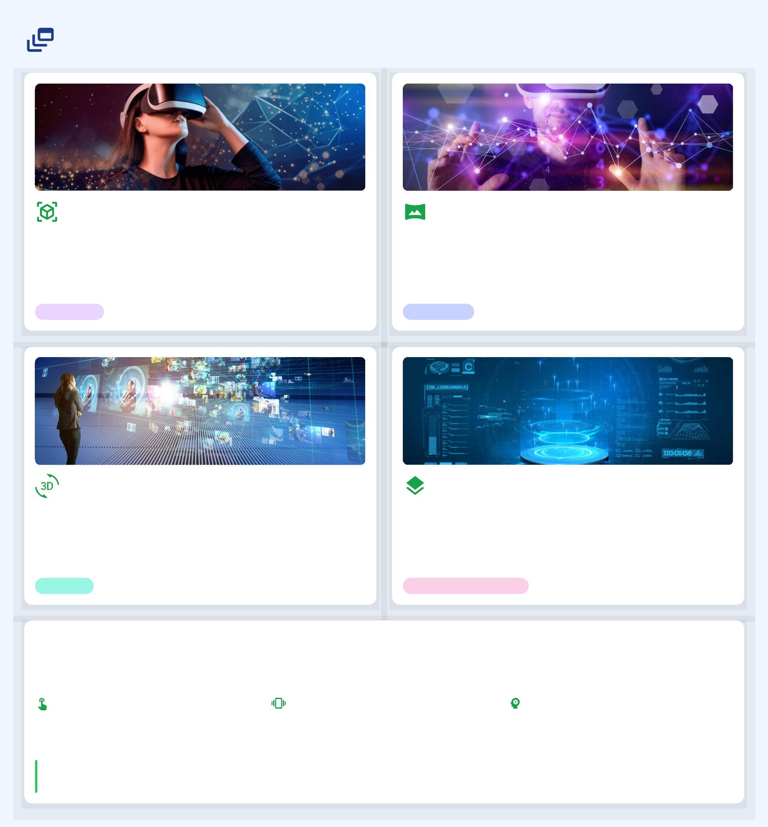
Output Methods: Immersive Feedback
Augmented Reality (AR)
Virtual Reality (VR)
AR overlays digital information onto the real world,
enhancing perception and interaction. It blends virtual
objects with physical environments, creating interactive
experiences.
VR creates fully immersive simulated environments,
transporting users to digital worlds. It provides a sense of
presence and allows for deep engagement with virtual
content.
Immersive
Interactive
3D Displays
Holography
These displays provide stereoscopic visuals without the need
for special glasses, oﬀering depth perception and a more
natural viewing experience for digital content.
Holography projects true 3D images into space, allowing for
interaction with virtual objects that appear to exist
physically. It oﬀers unparalleled realism in visual output.
Realistic
Enhanced Perception
The Importance of Feedback in HCI
Output devices are crucial for providing feedback to the user, closing the loop in human-computer interaction. The more
sophisticated this feedback, the more eﬀectively users can accomplish tasks.
Perceptual-Motor Interaction: Users'
perceptions are linked to their physical
actions, with systems providing feedback
to guide subsequent moves.
Tactile & Force Feedback: Providing
physical sensations to enhance realism and
inform user actions, especially in virtual
environments.
Reduced Cognitive Load: Eﬀective
feedback can diminish processing
demands, freeing up cognitive capacity for
other tasks.
"The more sophisticated the interaction between input and output devices—the more complex the feedback loop between the
two directions of information ﬂow—the more the human user will be able to accomplish with the machine."
Source: Human-Computer Interaction | EBSCO Research Starters, Input Devices and Interaction Techniques for Advanced Computing

Slide 15
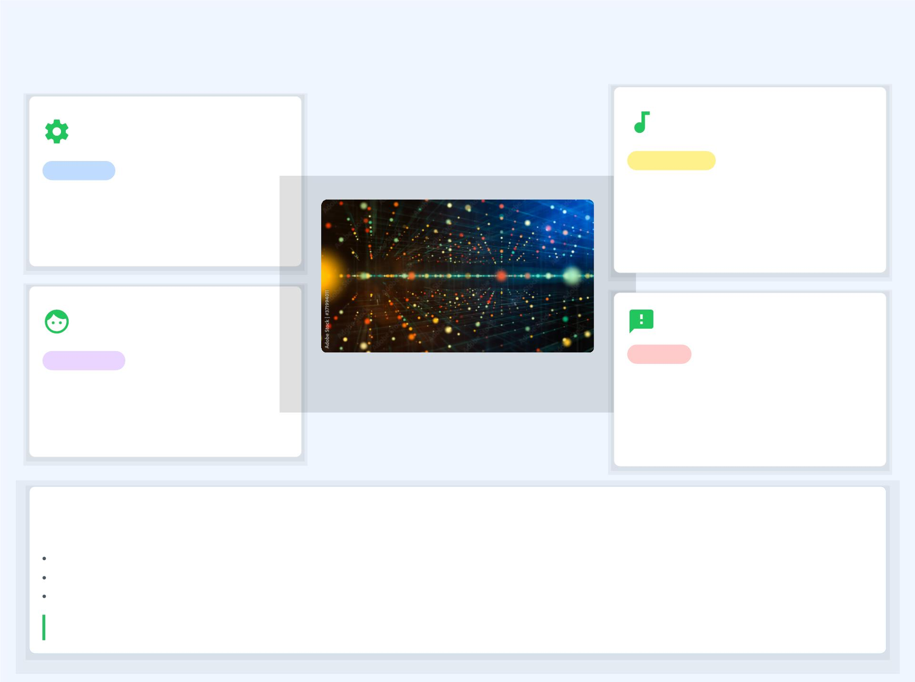
The Future of UI: Seamless & Intuitive
Context-Aware
Interfaces
Integration with AI &
ML
ADAPTIVE
INTELLIGENT
UIs will intelligently adapt to the user's
environment, activities, and intentions,
proactively providing relevant information
and minimizing explicit commands.
AI and machine learning will be
foundational, enabling predictive
capabilities, natural language
understanding, and sophisticated pattern
recognition for intelligent interactions.
Personalized
Experiences
PREDICTIVE
Ethical Considerations
ETHICAL
Interfaces will be highly customized to
individual preferences, behaviors, and
learning styles, with adaptive layouts and
content that evolve with the user.
As UIs become more pervasive, ethical
design is paramount. This includes
ensuring data privacy, algorithmic fairness,
and preventing manipulative design
patterns.
The Promise of Seamless Interaction
The ultimate goal is to make technology disappear, allowing users to focus on their goals, not the interface. This involves:
Ubiquitous Computing: Technology embedded seamlessly into everyday objects and environments.
Natural Dialogues: Interactions that mimic human communication through voice, gesture, and even thought.
Reduced Cognitive Load: Interfaces that require minimal mental eﬀort for more ﬂuid and enjoyable experiences.
"As HCI advances... notions of the computer as an object separate from the user may eventually be relegated to the archives of technological history, to be replaced by
wearable machine interfaces..."
Source: Human-Computer Interaction | EBSCO Research Starters, Input Devices and Interaction Techniques for Advanced Computing

